Slide 1
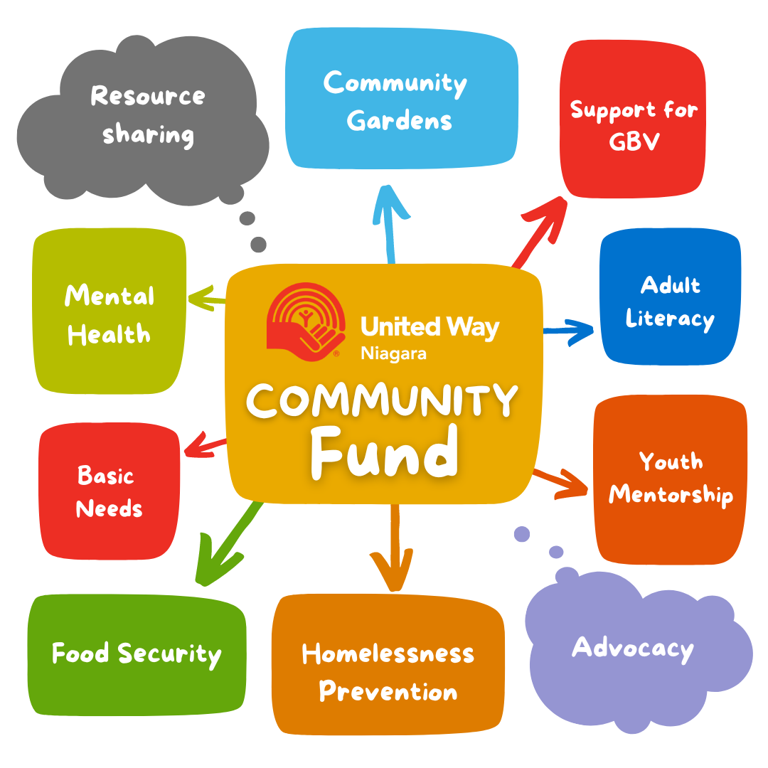

Where does the
money go?
#WhatWeDo

Slide 2
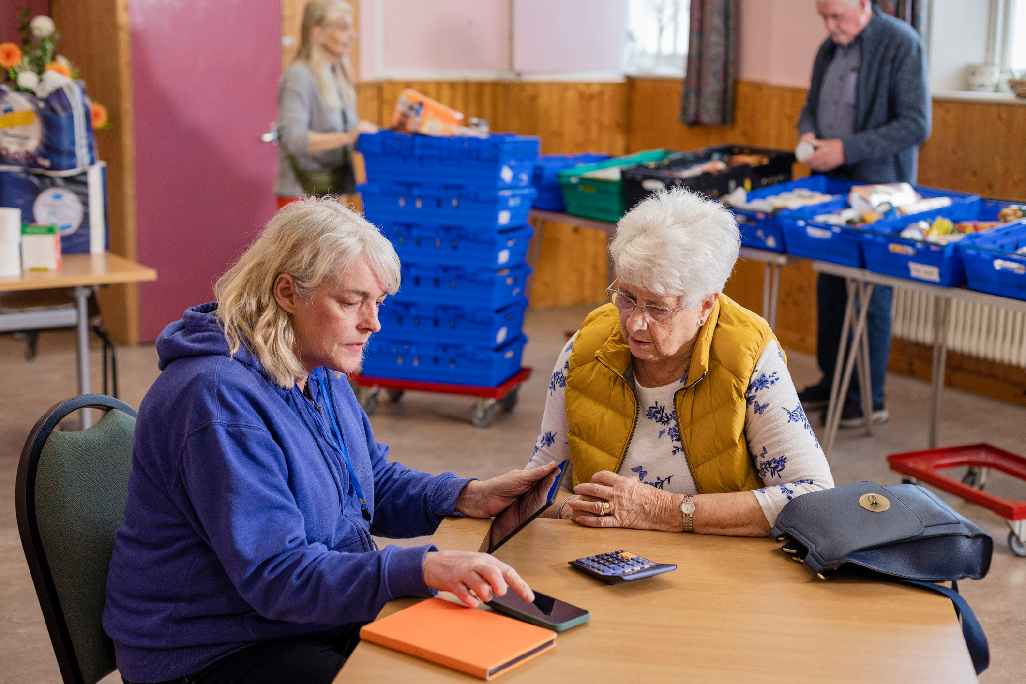

Improve income & financial literacy

Slide 3


#WhatWeDo
We invest in programs that...
Increase income/employment
Stabilize/maintain housing
Increase food security
Provide basic needs

Slide 4



Lift families
out of poverty

Slide 5

Providing basic needs
  In 2024, United Way Niagara helped provide 796,033 meals, 12,055 emergency shelter nights, and responded to 24,747 crisis calls.
  Distributed:
  4,000 hygiene kits
  275 Welcome Home Kits
  Products shared with over 60 agencies to support vulnerable individuals and families.
COMMUNITY INITIATIVES

Slide 6

Provide healthy food and increased food access

Slide 7
Where does the
money go?
#WhatWeDo

Slide 8
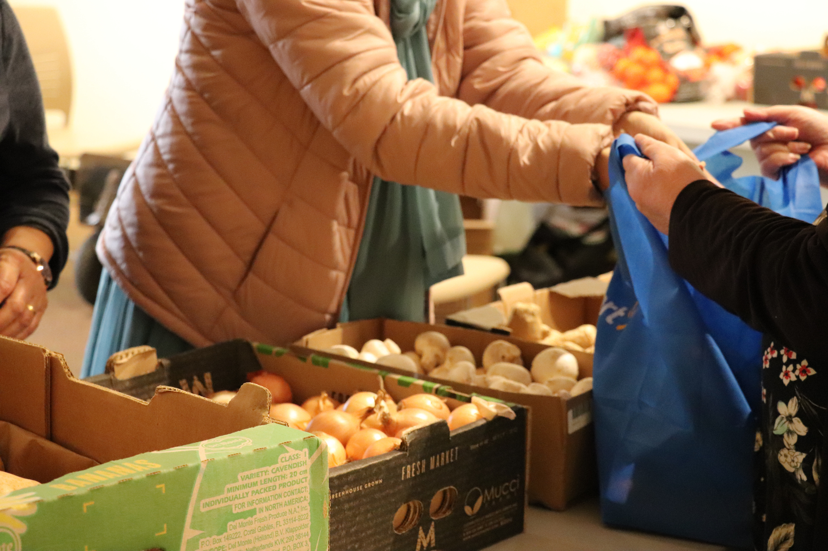
#WhatWeDo
We invest in programs that...
Increase healthy food access
Improve food literacy
Feed children & youth
Provide emergency food

Slide 9
Increase
food security

Slide 10

Supporting families
  606 families and individuals were supported to stay housed.
  Backpacks for Kids distributed 2,775 backpacks to children in 100 schools.
  Programs like Happy in My Home helped deliver over 50,000 meals to seniors, reducing caregiver strain and preventing hospital visits.
  With stability at home, families can focus on what matters most- growing, learning, and thriving.
COMMUNITY INITIATIVES

Slide 11

Create community
& foster inclusion

Slide 12

#WhatWeDo
We invest in programs that...
Break the cycle of violence
Improve personal safety
Increase social connections
Foster inclusivity for all

Slide 13
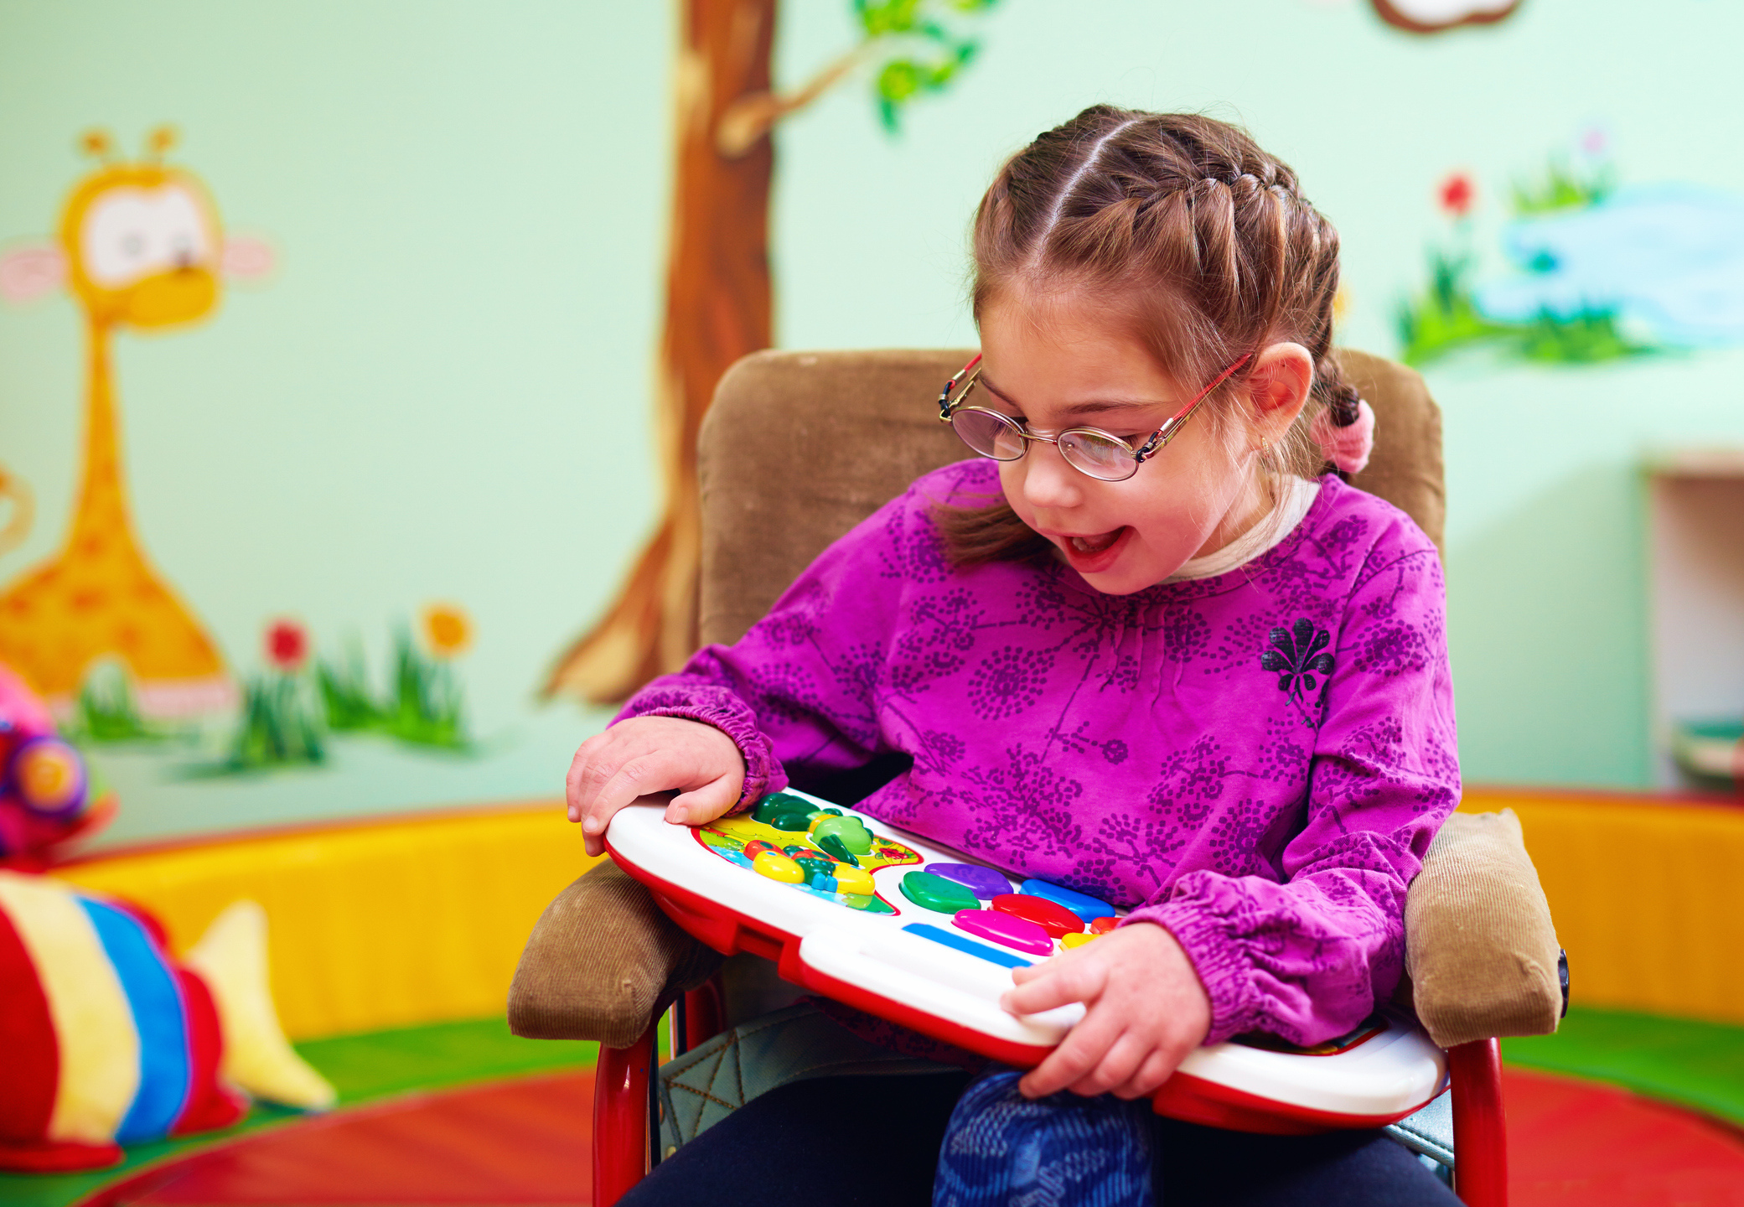

Improve
well-being

Slide 14
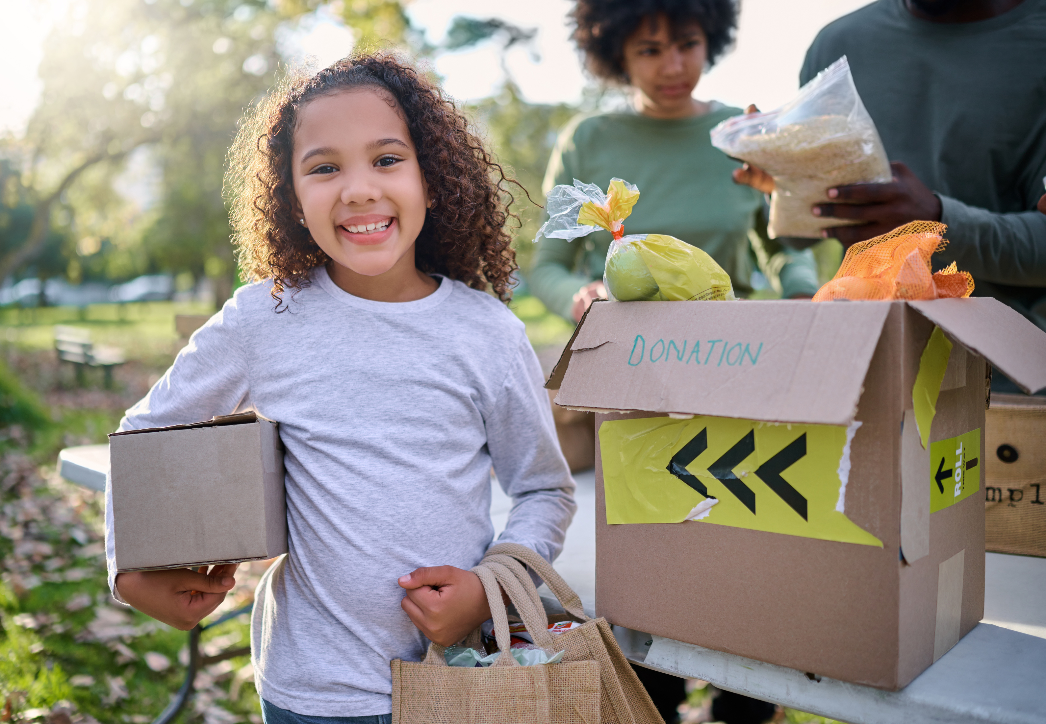
Prevent youth
homelessness

Slide 15

Breaking barriers, creating opportuntities for youth
  2,269 youth accessed enriching after-school programs.
  Programs like After School Matters served 1,940 snacks/meals and provided 760 hours of homework help.
  Nearly 1,000 young lives positively impacted through mentorship with Big Brothers Big Sisters Niagara.
  Mentorship, meals, and safe spaces help kids reach their full potential, no matter their circumstances.
COMMUNITY INITIATIVES

Slide 16
Where does the
money go?
#WhatWeDo

Slide 17

#WhatWeDo
We invest in programs that...
Provide opportunities for kids
Level the playing field
Address food insecurity
Enhance learning

Slide 18

Alleviate financial barriers for families

Slide 19
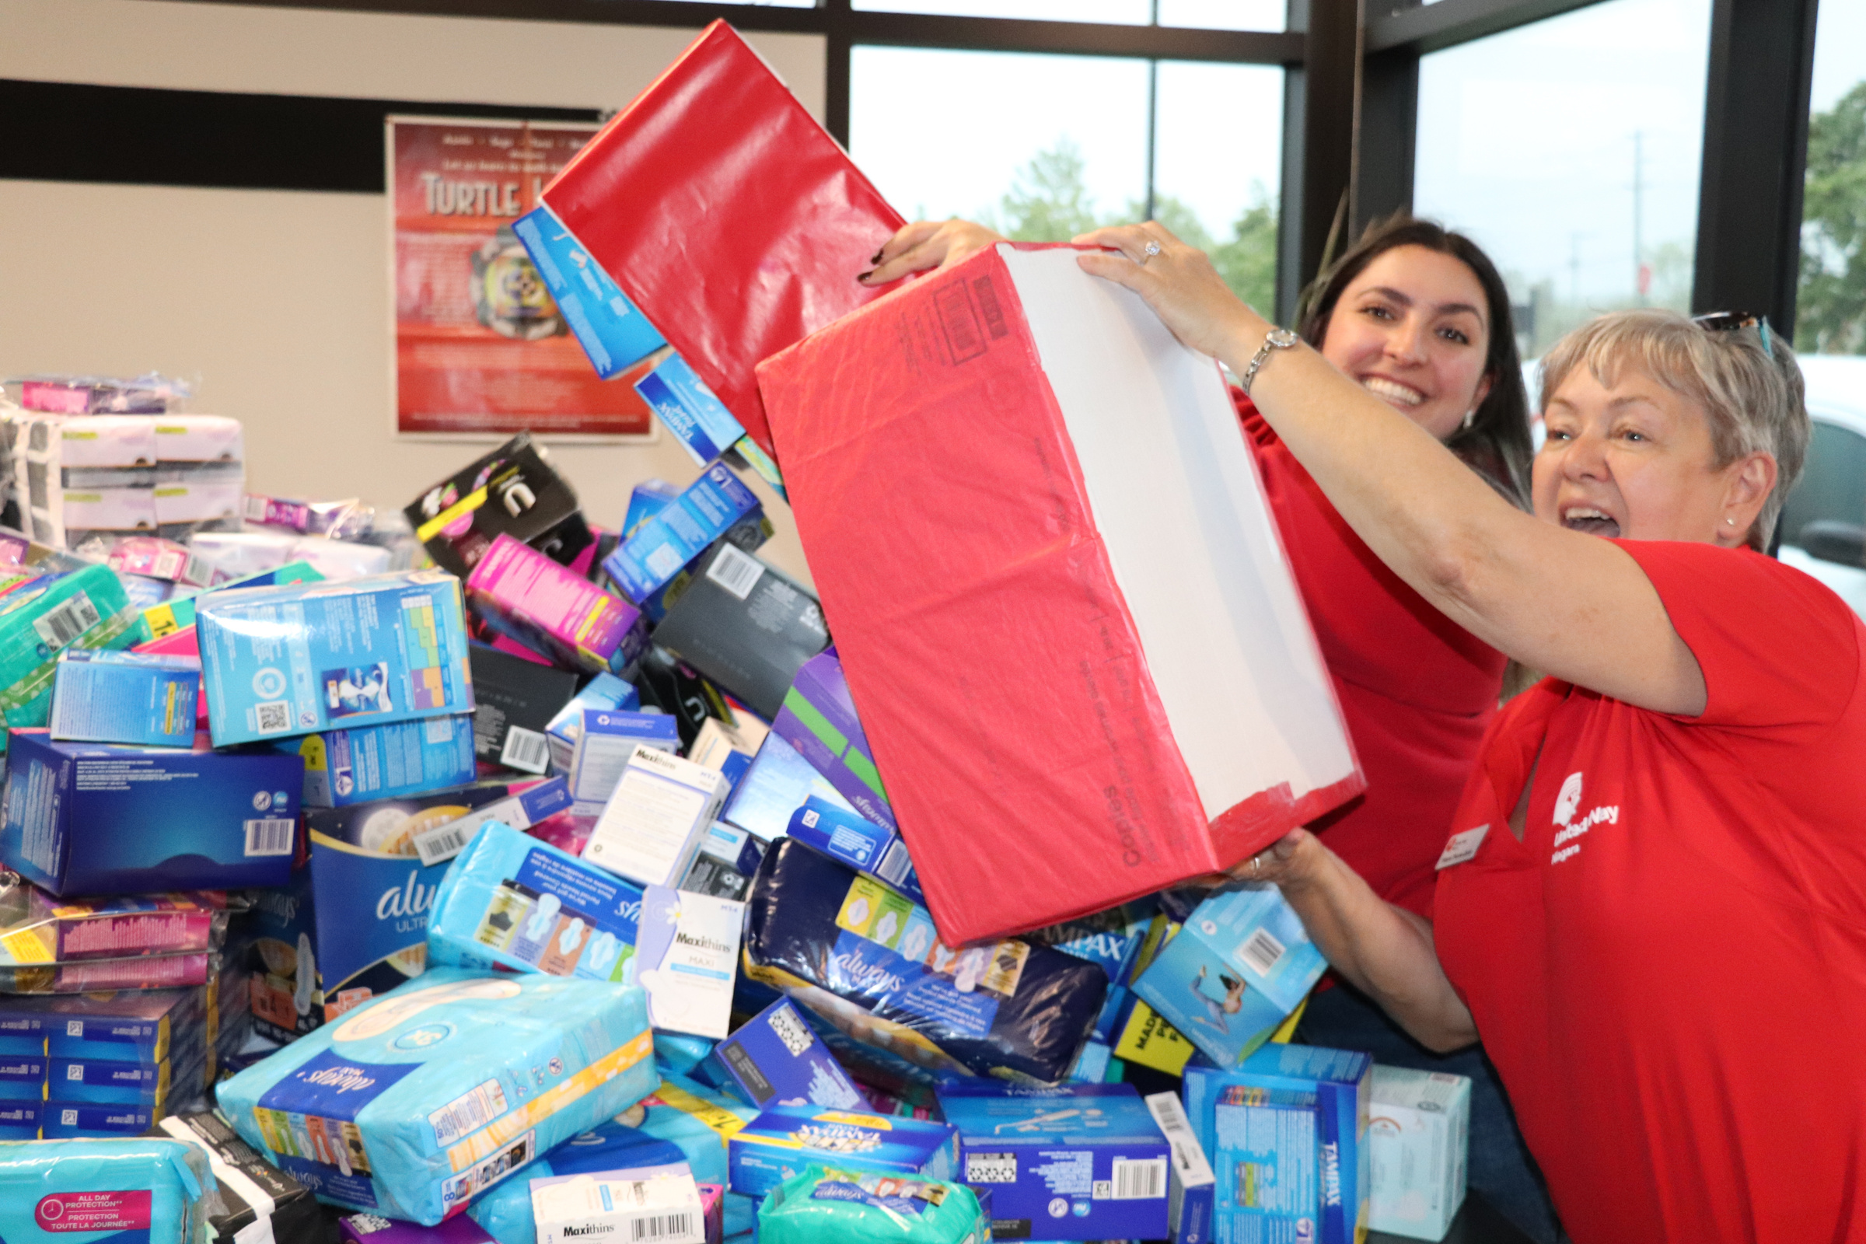
Advocating for menstrual equity
  Period Promise campaign collected over 84,000 products.
  Distributed 93,758 products through 50+ partners across Niagara.
  Helps reduce stigma, restore dignity, and ensure everyone has access to basic menstrual products.
  Periods are a fact of life, access to products should be too.
COMMUNITY INITIATIVES

Slide 20
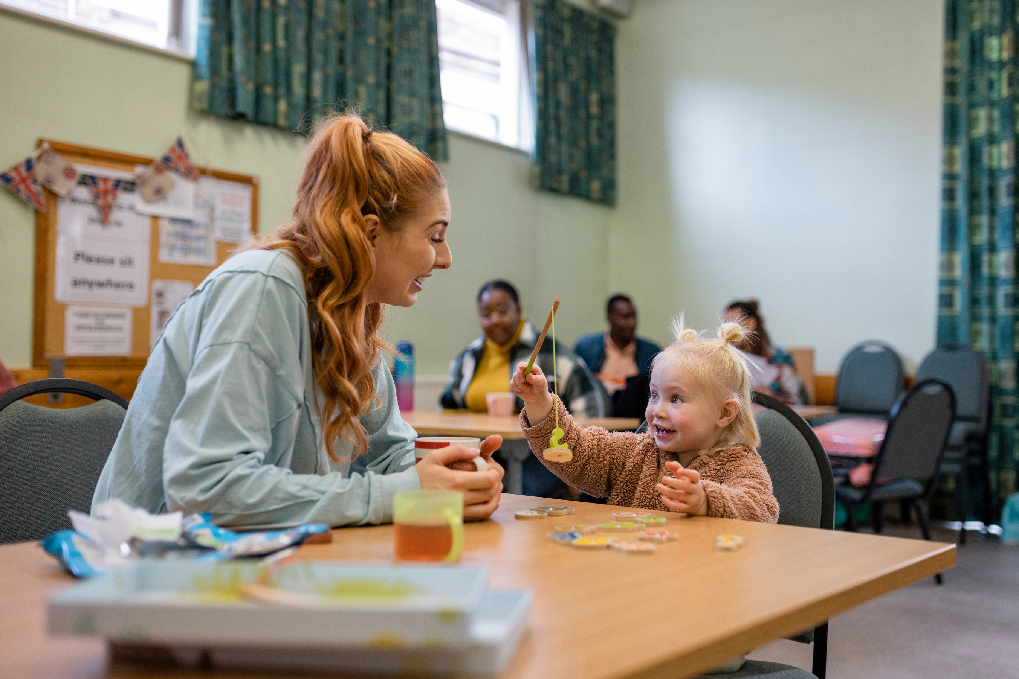
Support parents &
their children

Slide 21
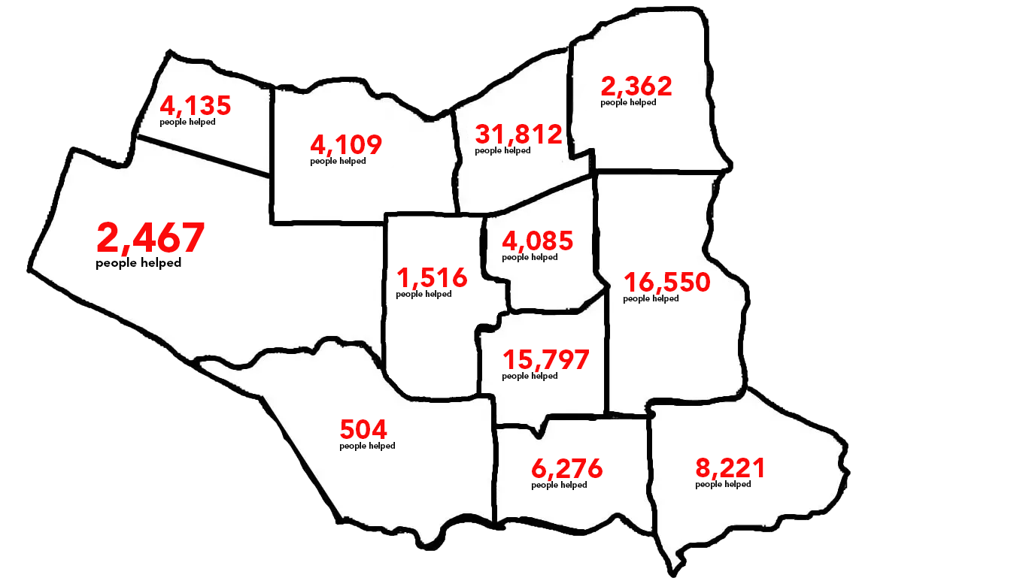
One Gift. Widespread Impact.
*numbers based on available information from agency reporting

